Slide 1
Course Introduction
Welcome to CSE 390B!
Introduction to CSE 390B, Course Logistics, and Programming Projects Overview

Slide 2
Lecture Outline
What is CSE 390B About?
  Overview of CSE 390B
  Why the Course Matters
Course Logistics
  Lectures and Assignments
  Course Policies and Expectations
Programming Project Series
  Nand2tetris Overview
  Tools demonstration

Slide 3
What is CSE 390B?
The UW Student Experience
Math
Metacognitive
Skills
CSE
Nand2tetris
Projects
Sociology
CSE 390B

Slide 4
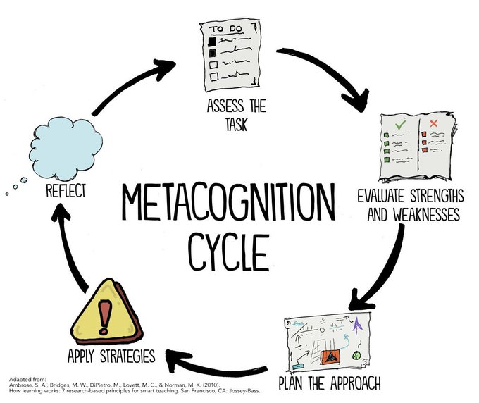
Metacognitive Skills
What does metacognition mean?
  Awareness of your thought processes
Metacognitive skills we will cover:
  Time Management
  Annotation Strategies
  Test-Taking
  Note-Taking
  Written & Oral Communication
  Testing & Debugging
  Design Decisions

Slide 5
The Connection
How do the different elements of practicing metacognitive skills and working on technical projects connect?
DEFINE & PREPARE
Introduce technical content and a new metacognitive skill
REFLECT
PRACTICE!
What was challenging? What worked well?
Applying knowledge through weekly projects

Slide 6
Technical Sneak Peek of CSE 390B
Fascinating question:
  What happens under the hood when code runs?
Fascinating answer:
  Many layers of abstraction, each with its own answer
Nand2tetris: Project for exploring bottom-up layers
  Can do everything with NAND gates and input / output
Empowering: A coordinated, broad look at “how computers really work”
  Closest to the Hardware / Software Interface CSE 351 but lower level, with elements from Digital Design (CSE 369), Operating Systems (CSE 451), and Compilers (CSE 401)

Slide 7
Why Does CSE 390B Matter?
Technology is based on bottom-up computing
  Learning how computers work is foundational to computer science
  You’ll see the birds-eye view of computer science and understand how your courses fit into the big picture
This course equips you with a toolbox
  A CSE degree isn’t just about learning technical concepts
  A college education is also about preparation for a career and your future (collaboration, organization, etc.)
This course empowers you to explore
  You will become independent learners and be autonomous in your learning for future UW courses and beyond

Slide 8
Lecture Outline
What is CSE 390B About?
  Overview of CSE 390B
  Why the Course Matters
Course Logistics
  Lectures and Assignments
  Course Policies and Expectations
Programming Project Series
  Nand2tetris Overview
  Tools demonstration

Slide 9
Succeeding in CSE 390B
This course will have frequent assignments and move through many topics
  Stay organized, falling behind makes it difficult to catch up
  You will not be successful in this course if you wait until the day before to do your assignments
This course rewards participation
  Lecture participation and TA meetings are expected
  In-class activities are meant to help you with your weekly projects
This course is not a way to earn an easy 4.0
  What you get out of the course is what you put in
  Not the course to “boost” your GPA
  We expect students to work hard and give their best effort

Slide 10
Course Staff Roles
Eric
Teaching the technical (bottom-up computing) and metacognitive (academic skill building)
Audrey, Sean, Ghislaine, and Preston
Weekly TA meetings as a touch point in practicing the application on course concepts and study skills
The UW Student Experience
CSE
Metacognitive
Skills
Math
Eric!
Nand2Tetris
Projects
Audrey, Sean, Ghislaine, & Preston!
Sociology
CSE 390B

Slide 11
Logistics: Grading Breakdown
50%: A sequence of eight projects
  Each will have a metacognitive and technical, programming component
  Projects will be assigned on Thursdays and generally due the following Thursday
15%: Midterm Examination
15%: Final Project & Presentation
20%: Participation
  10%: Lecture attendance and Poll Everywhere questions
  10% Student-TA meeting attendance and engagement

Slide 12
Logistics: Academic Integrity
Work to be completed and submitted individually
  Do not share your solutions with others
Collaboration allowed and encouraged, but discussions must be at a high-level
  You may share implementation strategies and debugging tricks, but NOT lines of code or your entire solution
Do not seek answers or solutions from those not in the class or from the website
If you have any questions about what is considered academic integrity or not, please ask the course staff

Slide 13
Logistics: Student-TA Meetings
Weekly 1:1 Student-TA Meetings
  A required element of the course (factored into participation grade)
  45 minutes each week (the first meeting will be one hour)
  1:1 Student-TA meetings will begin Week 2 based on the availability of you and the TA
Student Expectations
  Come prepared, on time, and ready to work
  Absences or frequent reschedules will negatively impact your grade
  See syllabus for additional information and policies
TAs will coordinate the first Student-TA Meeting

Slide 14
Logistics: Lecture Pre-readings
Short readings to be completed before each lecture
  Posted under the course calendar under each lecture
Allows for more student interaction and engagement with course material during lecture
  Individual or group work during lecture for project preparation
Research shows that “active learning” leads to improved learning and better grades (Freeman et al., 2014)
  Added benefit of interacting with your peers and the course staff
Freeman, Scott et al. “Active learning increases student performance in science, engineering, and mathematics.” Proceedings of the National Academy of Sciences of the United States of America 111, 23 (2014): 8410–8415. https://www.pnas.org/content/111/23/8410.

Slide 15
Logistics: Lecture Polling
A way for you to instantly practice and solidify the concepts covered in lecture
  Research shows the act of thinking about an application question is a highly effective way to learn
Factored into participation grade (completion only)
We will be using Poll Everywhere
  Sign up now for an account at https://pollev.com/
  New policy that requires SSO log-on

Slide 16
How will Poll Everywhere be used in lectures?
To grade you on whether you get the questions we ask correct
To aid your learning by giving you a chance to practice applying the material we are covering
To factor into the participation grade based on correctness of responses
To see who is paying attention during lecture
We’re lost…

Slide 17
Logistics: Late Policy
Five late days for the quarter
  Do not need to tell the course staff ahead of time
  Maximum of two late days can be used per project
  Use late days wisely, intended to offer additional flexibility
Under extenuating circumstances, you may make an extension request
  Only considered if the request is made before the project deadline
  See syllabus for extension request instructions
You are guaranteed to pass the course if you meet all minimum passing requirements of each project
  Importance of staying persistent and resilient

Slide 18
Logistics: Late Policy
Projects submitted past late days allotted or new deadline via extension request will receive a 10% deduction per day
Example scenario: Submitting a project three days late would use two late days and receive a 10% deduction

Slide 19
Logistics: Course Resources
Course Webpage
  Main source for everything related to CSE 390B
  Includes syllabus, course calendar, project specifications, and all the relevant resources for the course
Canvas
  Access to lecture recordings via Panopto
  Check remaining late days (updated after every project)
  Accessing necessary resources for projects
Mailing Lists
  Course staff will reach out via cse390b_sp22@uw.edu for urgent course announcements
  Email cse390b-staff@cs.washingtonn.edu for any urgent matters

Slide 20
Logistics: Course Resources
Ed Discussion Board
  The place to ask and answer questions related to the class (logistics, projects, general questions, etc.)
  Course staff will post non-urgent announcements here
GitLab
  Project distribution and submission
Gradescope
  Where you will submit the metacognitive parts of the projects
  You will receive your project grades and feedback here

Slide 21
Meet Your Peers
Introduce yourself! Share your name, pronouns, and a unique fact about yourself
Share what you are excited for in CSE 390B
Share what you are concerned about in CSE 390B
Appoint a facilitator to steer the conversations
Appoint three presenters: (1) Share the names in your group, (2) share one excitement about CSE 390B, and (3) share one concern about CSE 390B

Slide 22
Five-minute Break!
We’ll take a five-minute break close to the middle of every lecture
  Feel free to stand up, stretch, use the restroom, drink some water, review your notes, or ask questions
We’ll be back at:
Research shows that mid-lecture breaks reduce the decline of attention (Olmsted, 1999)
Any song recommendations? Respond on Poll Everywhere at https://pollev.com/cse390b
Olmsted III, John. “The Mid-Lecture Break: When Less Is More.” Journal of Chemical Education (1999). https://pubs.acs.org/doi/abs/10.1021/ed076p525.

Slide 23
Lecture Outline
What is CSE 390B About?
  Overview of CSE 390B
  Why the Course Matters
Course Logistics
  Lectures and Assignments
  Course Policies and Expectations
Programming Project Series
  Nand2tetris Overview
  Tools demonstration

Slide 24
Programming Project Series
nand2tetris
  You will build an entire (simulated) computer
  Source: Single hardware logic gate
  Destination: A computer program that runs a game of Tetris
  Topics: Hardware concepts (Boolean logic, sequential logic, computer chips, etc.), low-level software, fundamentals of operating systems, virtual machines, compilers
Acknowledgements
  Projects adapted from the open-source nand2tetris curriculum
  Everything you need will be distributed by the course staff

Slide 25
Programming Project Series
Getting your assignments
  You will have your own GitLab repository for the quarter
    For distributing starter code
    Used for organizing and submitting your projects
Specifications, textbook chapters, and references will be on the course website
  We’ll provide the instructions you need for using Git

Slide 26
Programming Project Series
Roadmap for completing the programming projects:
In lecture:
Read spec & textbook chapter about specific application
Technical concepts
Try writing code in your preferred text editor
Metacognitive skills
Test & debug using provided simulator tools
Complete reflection on the process

Slide 27



Course Infrastructure Demo
Understanding and using Git
Find your CSE 390B GitLab Repository
Add your SSH Key
Explore the starter code using your favorite editor
Make a commit
Steps outlined in detail in Project 1 website

Slide 28
Project 1 Overview
Programming Component: GitLab Setup
  Will prepare for future CSE 390B projects
Metacognitive Component: Course Resources Worksheet and Project 1 Reflection
  Organize your resources for this spring quarter
  Identify key learning resources that you will be accessing throughout the quarter
Estimated time to complete: 30-60 minutes
Project 1 due this Thursday (3/31) at 11:59pm PDT

Slide 29
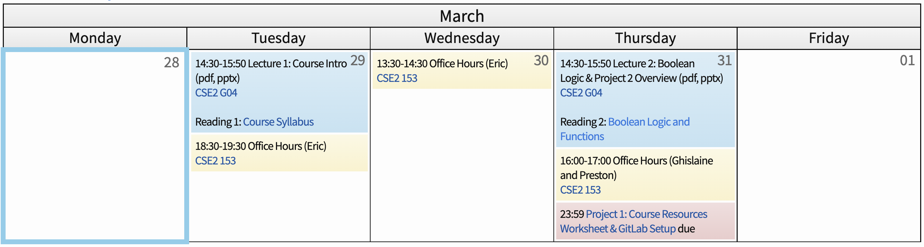
Lecture Readings
First lecture reading is posted on the course calendar
  Please complete it before lecture this Thursday
  Jot down your questions and ask them this Thursday
The reading should take around ten minutes
  Intention of pre-readings is initial exposure, not mastery

Slide 30
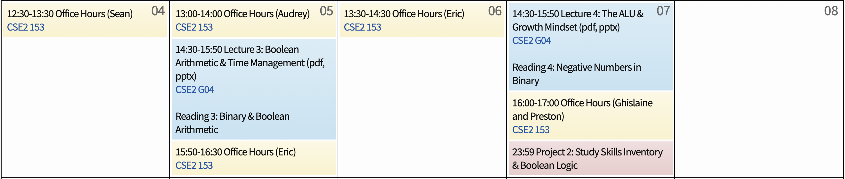
Wrapping Up
Project 1 due Thursday, 3/31 at 11:59pm PDT
Office hours times and locations on course calendar
  Feel free to stop by to just work on projects or say hello!
Use the Ed Discussion Board to ask and answer questions
See you all on Thursday! 👋

